Slide 1
OOPS
PROJECT
STUDENT ATTENDANCE SYSTEM

Slide 2
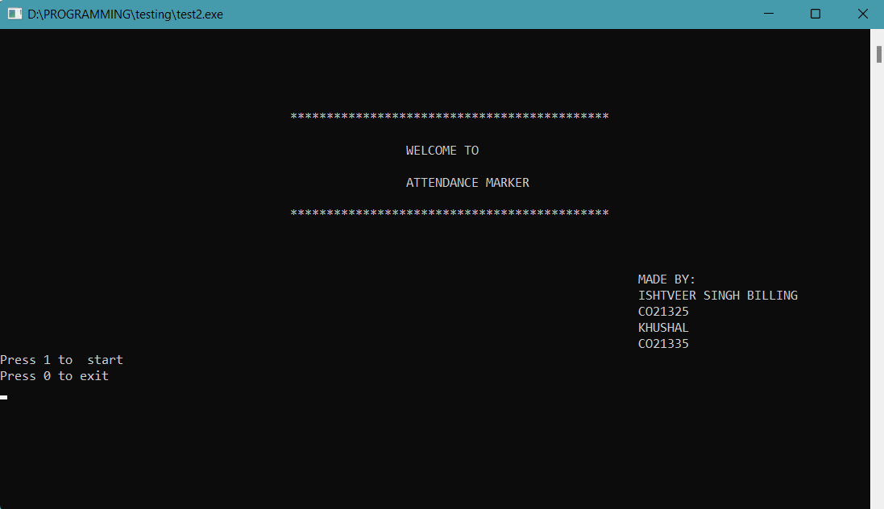

Slide 3
OBJECTIVES
Main motive of the project is to keeping data of whole class at one place which is easily accessible and help in other areas as well rather than writing it on a register or a hard copy.
Keeping record of students in the class.
Their attendance record.
Net attendance of each student in a list along with their names.
Teacher can easily edit past attendances as students often forget to say ‘present’ when their turn comes.

Slide 4
OTHER MODELS
Student operated model
This model was based upon students provided with login details they use to login and mark their attendance.
Code Operated Model
This model was based upon a code given by teacher in class through which students can mark their attendance.

Slide 5
FALLACIES OF MODELS
In both of these models, there are high chances of false attendance by the student. A student absent can also have access to code through other students.
Thus this model provides a better alternative and hand total control in the hand of teachers and act like a digital register. Thus, there is no discrepancies in this system of attendance although it may take more time.
It brings teacher a new and safe-secured data storage with true and editable data and secure storage.

Slide 6
FEATURES OF MODEL
It brings many features like:
Unlimited classes, Can be used for whole college or school etc. There is no boundation upon number of classes
For now, there is support to add upto 1000 students total of all classes.
Upto 200 day’s worth of attendance can be stored for each student.
Model is easy to use for any subject teacher.
Doesn’t require much space.
Automatically skips to the required input rather than alike a form in which we have to move a cursor to go to next fields.
Extremely user friendly and to the point.
Does not require any pre-requisite skill to operate the program.

Slide 7
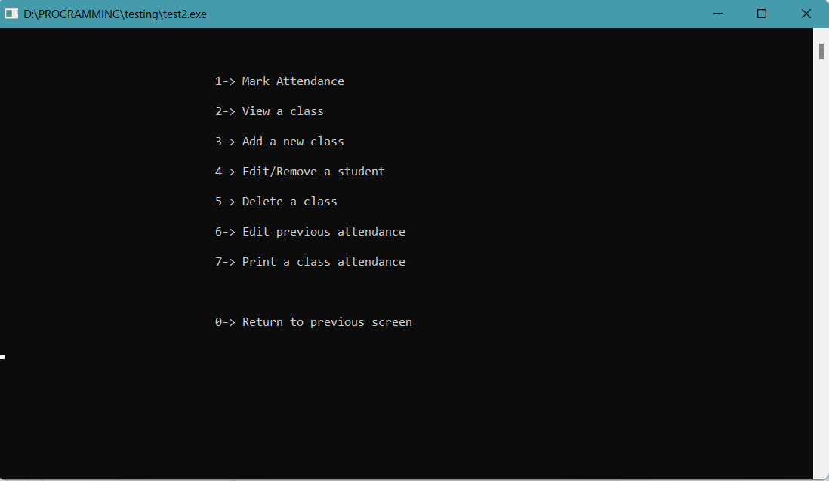

Slide 8
ALGORITHMS
OF EACH OPTION
GIVEN IN PROGRAM

Slide 9
MARKING ATTENDANCE
1.Enter details to access(only class code).
2.List of all students will load.
3. Mark attendance for each student.
4. Enter choice to mark other class(go to step 1 if yes).
5.Exit to main menu.

Slide 10
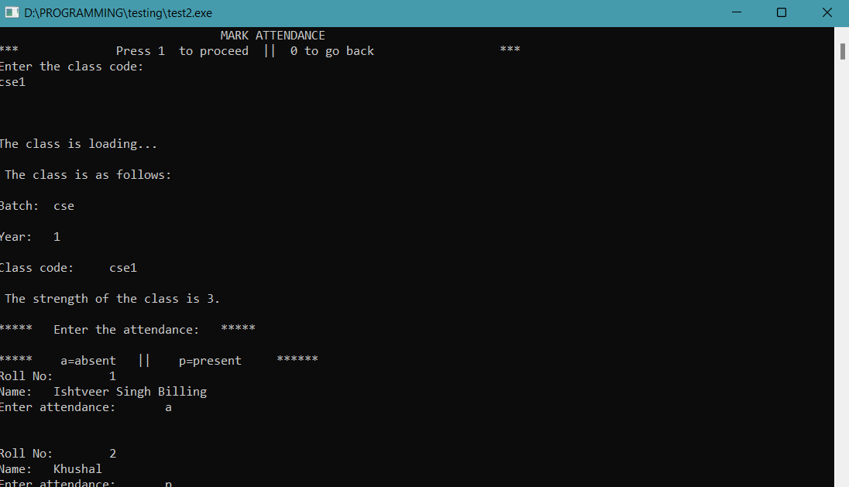

Slide 11
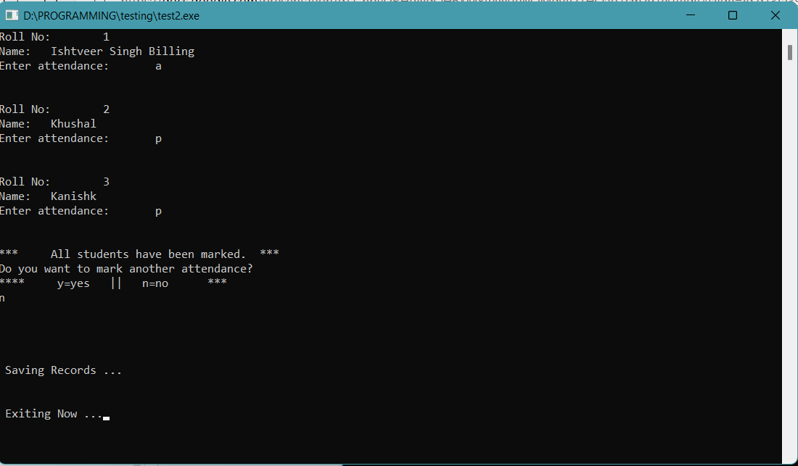

Slide 12
VIEWING A CLASS
Enter class code.
Loading class details.
Choice to view all students’ details.
Option to view another class.(step 1 if yes)
Return to main menu.

Slide 13
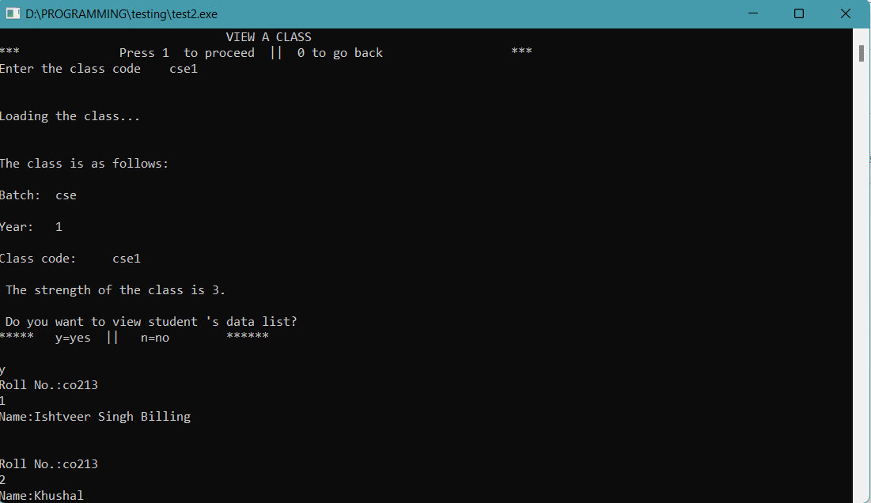

Slide 14
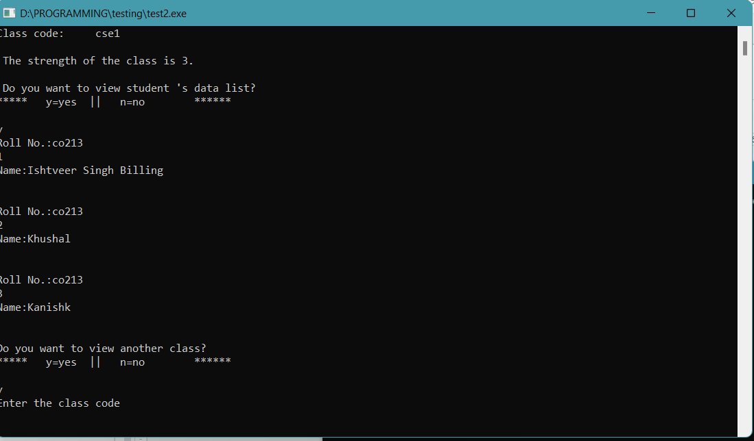

Slide 15
ADDING A NEW CLASS
Enter the details(branch name, year).
Generate a class code based on details for easy and single access.
Enter optional details(Roll code)
Input data of each student one by one.
Edit any wrong data entered.
View before saving.
Option to create other class(step 1 if yes)
Return to main menu

Slide 16
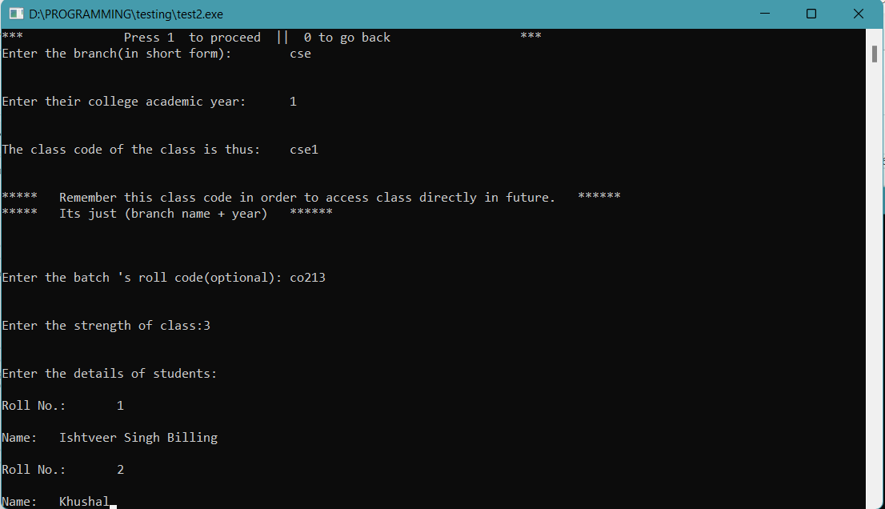

Slide 17
EDIT/REMOVE STUDENT
Edit a student case.
Enter pre-requisite details.(class code, roll no.)
Enter new details.
Remove a student case.
Enter details.
Verify consent.
Return to main menu.

Slide 18
DELETE A CLASS
1.Show all existing classes with their class data(class code, batch,, year, strength).
2.Enter class code to delete.
3. Verify consent.
4. Return to main menu.

Slide 19
EDIT PREVIOUS ATTENDANCE
1.Enter class code.
2.Enter date(day(only number) in present version).
3. Enter roll no.
4. Change the attendance to opposite.
5. Option to change other attendance.(step 1 if yes)
6. Return To Main Menu.
**Future updates will also have option to mark full class absent or present on a date for more options to teacher.

Slide 20
PRINT A CLASS ATTENDANCE
Enter class code.
Print all class data or a single student data.
Also show the total attendance of student and its percentage.
Print all a or p for each day in the attendance.
**Future update will also have feature to convert all this data into a excel file so that user can read in a better way.

Slide 21
THE FUTURE
OF THE
APPLICATION

Slide 22
FUTURE UPDATES
Add DBMS to make managing data more efficient and be able to store data as a secondary storage.
Add automatic date input from the computer used and bind the attendance results to that date.
More options and features to use for the ease of teachers.
Add user interface for easy interaction with the software.
Add different colors to increase readability.
Most imp.of it all, it’s all dynamic now, make a permanent storage to store data even after the exit from program.

Slide 23
MORE UPDATES
Creating a secure storage.
Provide security to avoid attacks and data manipulation by other programs or virus.
Generate a text file or preferable excel sheet with roll no, name, attendance,date and total attendance.
Add exception handling to auto -detect already existing classes and other data.

Slide 24


Slide 25

MADE BY:
ISHTVEER SINGH BILLING, CO21325
KHUSHAL, CO21335

